Slide 1


The TWA 3 Young Triple System
Ian Avilez
Northern Arizona University
Mentor: Lisa Prato
Lowell Observatory

Slide 2
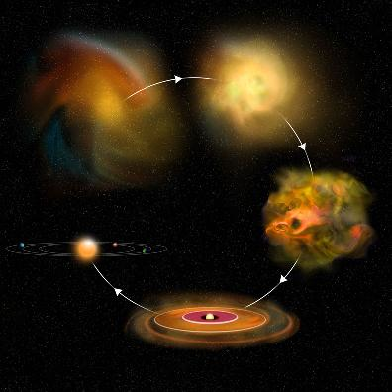
Stellar Formation
Credit: Bill Saxton, NRAO/AUI/NSF

Slide 3
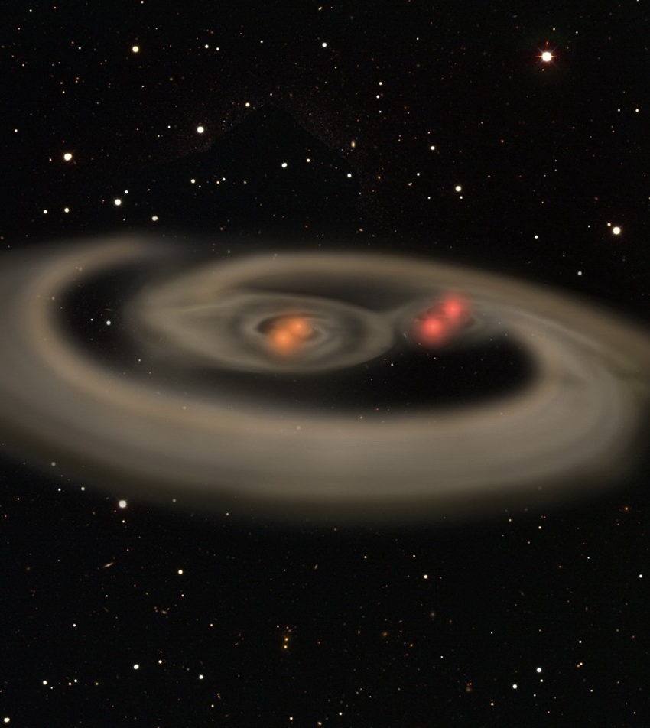
Multiple Star Systems
Credit: planetfacts.org

Slide 4
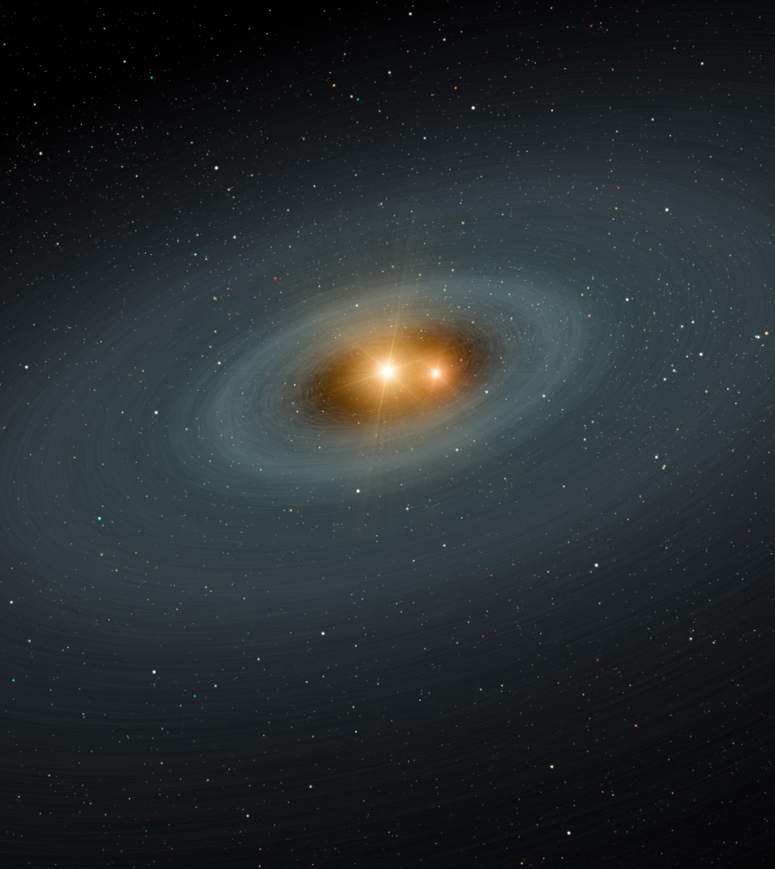
TWA 3
TW Hydrae Association
180 Light Years away
10 Million Years old
Triple system
  Spectroscopic Binary Period: ~ 34 days
  Visual Tertiary Period: hundreds of years
Credit: NASA/JPL – Caltech

Slide 5
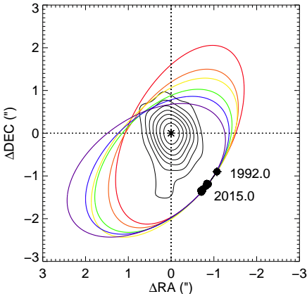
TWA 3
Black Contours: Dust in Circumbinary Disk (Andrews et al. 2010)
Colored Ellipses: Family of Orbits (Kellog et al. in prep)
Credit: Gail Schaefer

Slide 6
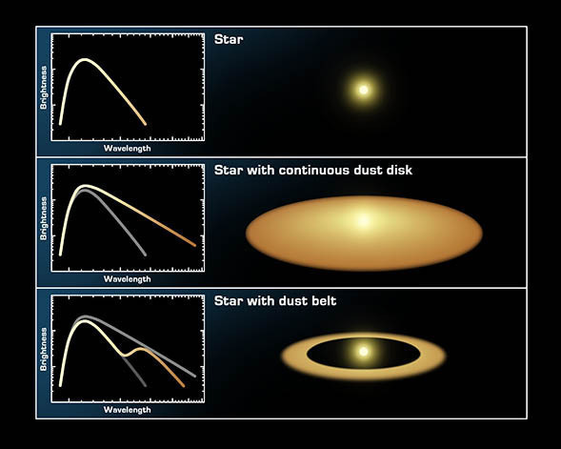
Spectral Energy Distribution (SED)
Looking at intensity of light at different wavelengths
Different wavelengths indicate different information
Wien’s Law
  Peak is proportional to 1/T
Credit: NASA/JPL-Caltech/T. Pyle (SSC)

Slide 7
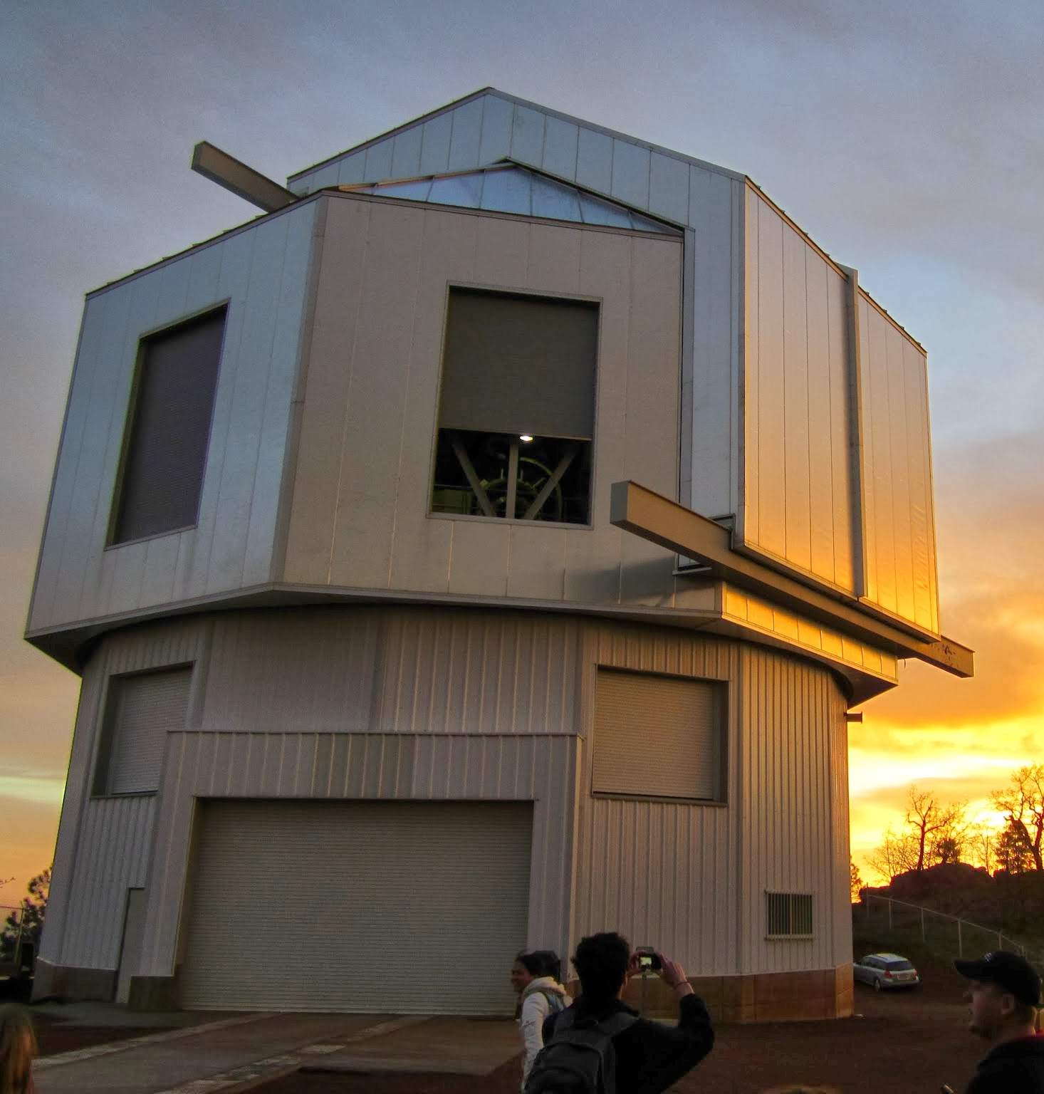
DCT Data
Credit: Ian Avilez

Slide 8
SED for TWA 3a and TWA 3b
TWA 3a
TWA 3b

Slide 9
Blackbody Fit for TWA 3A
Intensity
Wavelength

Slide 10
Next Steps
Determine temperatures of TWA 3B and Disk
Compare stellar properties to disk properties

Slide 11
Acknowledgements
Lisa Prato
Thomas Allen
Nuria Wright-Garba
Lauren Biddle
Nadine Barlow
Kathleen Stigmon

